Slide 1
TeleHealth
Talk To A Real Doctor.
No Copays.
No Hidden Fees.
No Insurance Mark-Ups.
Access Great Deals On Healthcare

Slide 2
Client
Dr. Ajay Bandi
Ph.D. Computer Science; Mississippi State University.
M.S. Computer Science; Mississippi State University.
M.S. Applied Computer Science; Northwest Missouri State University.
B.E. Electronics and Communication Engineering; Adhiparasakthi Engineering College, Anna University, Chennai, India

Slide 3
Our Team
Members :-
Venkat
Sri Vasavi Vipparla
Shivani
Nithya Karepe
Kunal

Slide 4
Objective
Make health care accessible to people who live in rural or isolated communities.
Make services more readily available or convenient for people with limited mobility, time or transportation options.
Provide access to medical specialists.
Improve communication and coordination of care among members of a health care team and a patient.
Provide support for self-management of health care.

Slide 5
Technologies
Proramming Languages
Java
HTML,CSS,Bootstrap
Jquery
JDBC
Servlet, JSP
Hibernate

Slide 6
Technical Requirements
Softwares
Apache Tomcat
Java 11
NetBeans 11.x
Mysql
SqlYog
GIT

Slide 7
Project Requirements
Step 1: -
User registration as doctor/ patient
Including entering user information like name, profile photo (optional) age, history of diseases, credit card information. User can add more information after completing information.
Step 2:-
User selects the type of doctor they want to see (eg. neurologist, dermatologist, dentist, etc.). They then see a list of corresponding doctors of the type with the price per appointment and button to book appointment
Step 3 :-
User selects to book an appointment through list of their selected doctor’s available time slots.

Slide 8
Project Requirements
Step 4 :-
User is now on book appointment page, where they enter their details and choose the time and date of their appointment
Step 5 :-
Users now get the appointment confirmation page, stating all information of the appointment. The user can also get to this page through their profile in the appointments section

Slide 9
Project Requirements
Step 7 :-
The meeting occurs,
Suggested diagnosis and medication updated on the website by doctor, or another session can be scheduled by doctor on end of appointment.
Step 8 :-
Doctor updates the medical record for the patient, which does not appear publicly on the user profile, but can be seen by the user when they are logged in. This can also be seen by the doctor

Slide 10
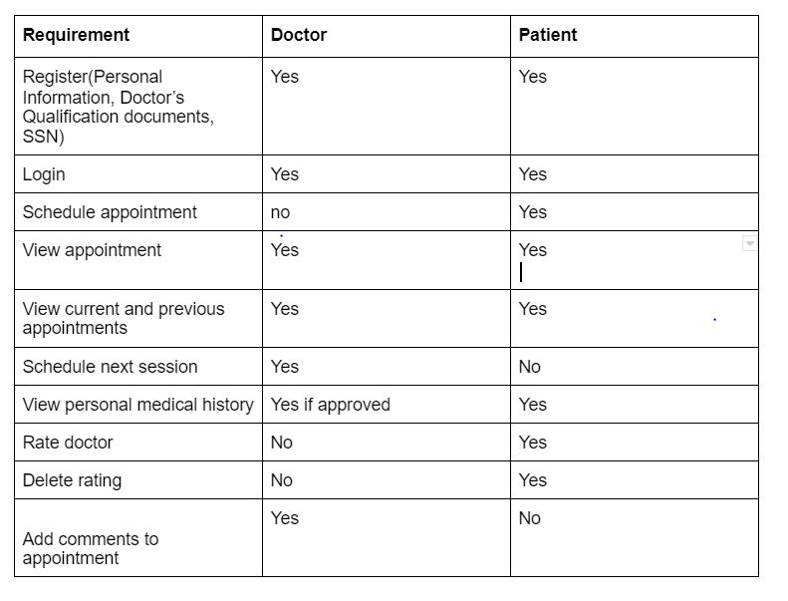
Project Requirements

Slide 11
Patient Login page:
•Patient logs in by using username and password if they are already registered.
•If they are new users, they have to register here.

Slide 12
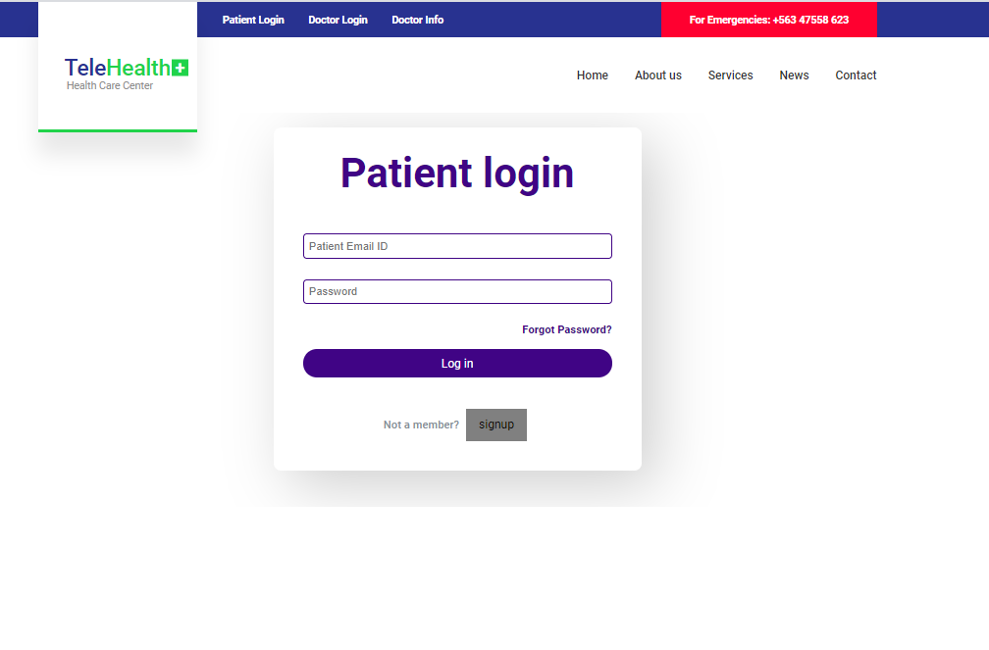

Slide 13
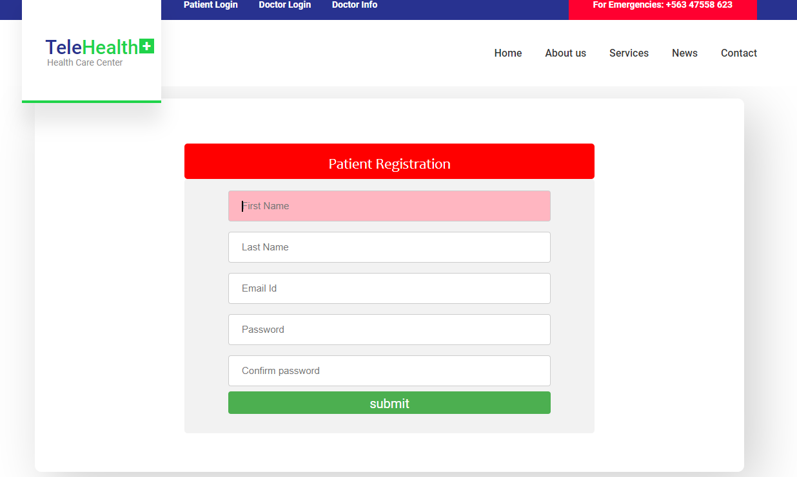
Patient Registration Form
In this form, patient will fill the details according to the given fields :

Slide 14
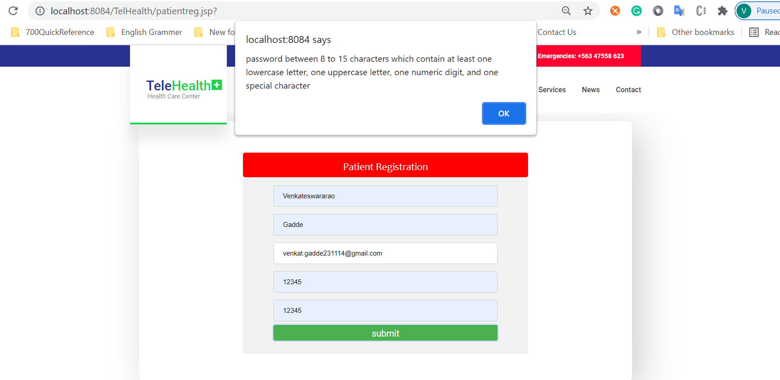
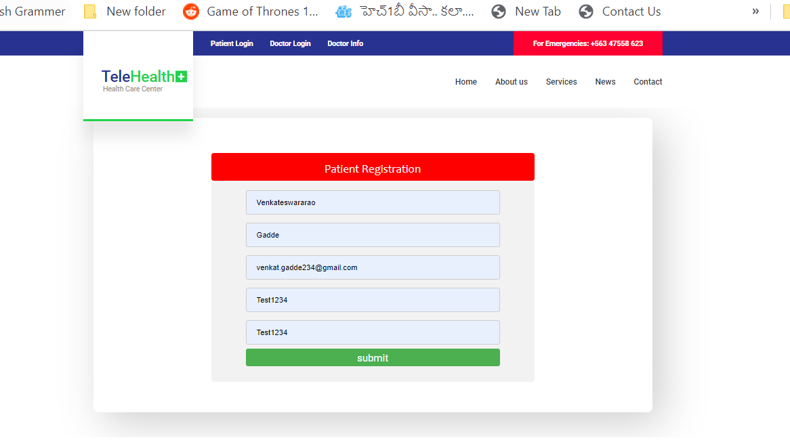

Slide 15
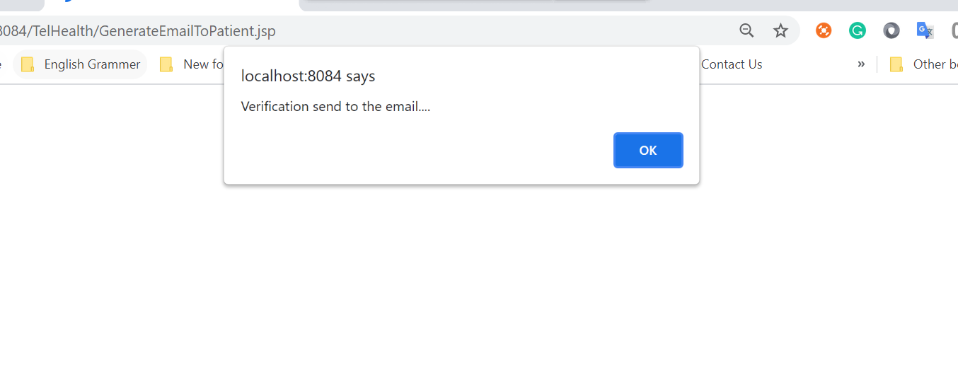
A verification mail is sent to the given mail id.

Slide 16
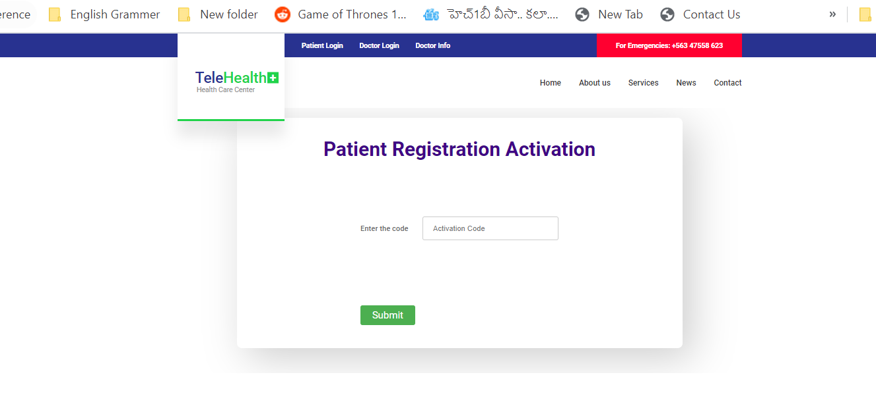
An activation code which is sent to the mail should be entered here.

Slide 17
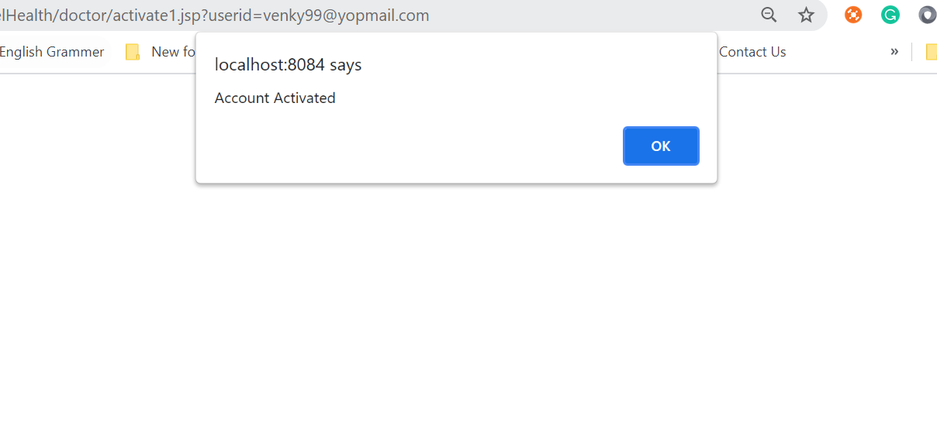

Slide 18
Doctor login page
•Doctor logs into the form by using username and password if they are already registered.
•If they are new users, they have to register here.

Slide 19
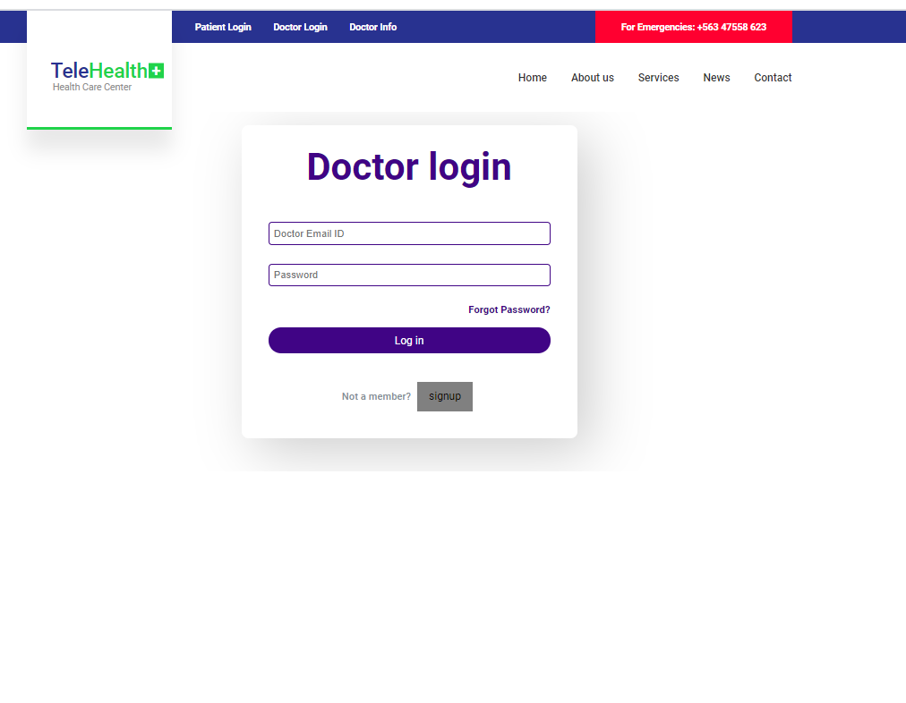

Slide 20
Doctor Registration page
In this form, Doctor will fill the details according to the given fields :

Slide 21
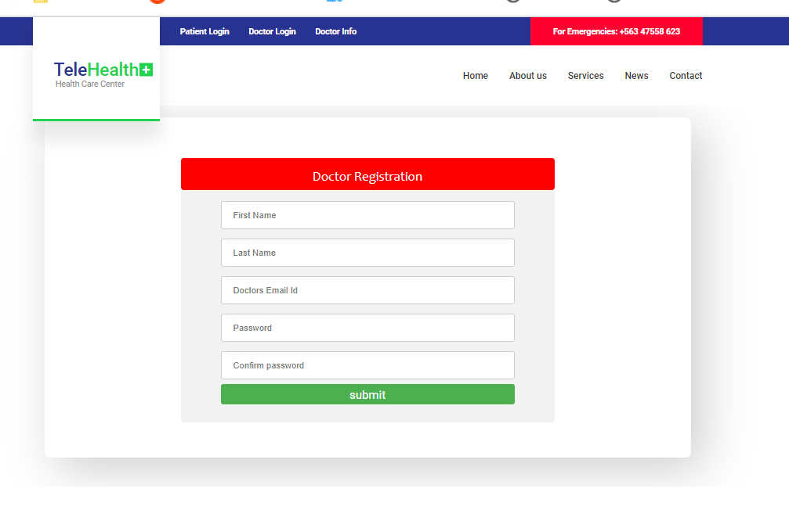

Slide 22
A verification mail is sent to doctor’s mail

Slide 23
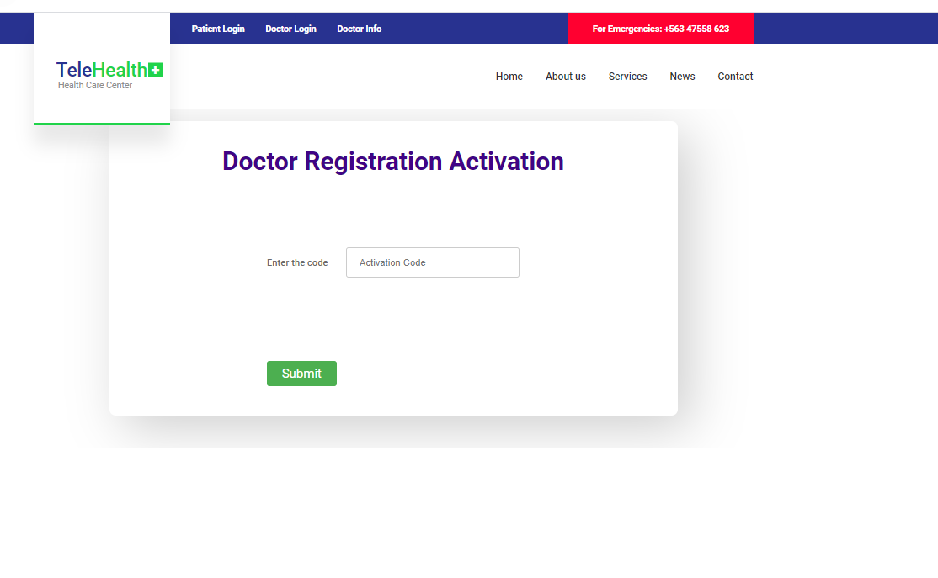
An activity code is sent to the mail which is submitted here

Slide 24
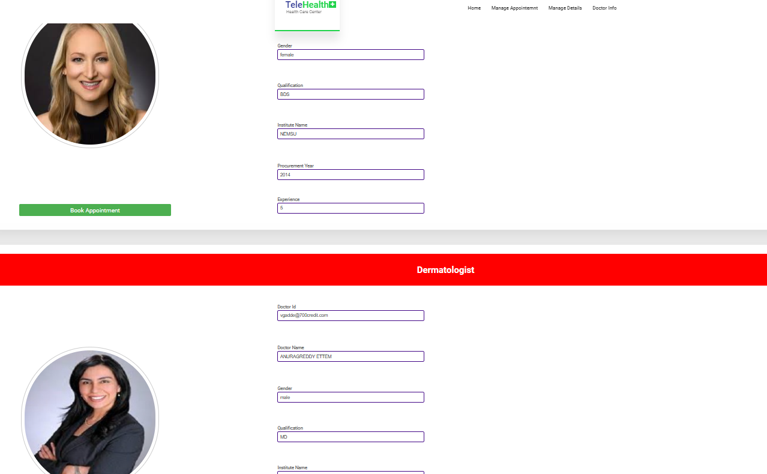

Slide 26
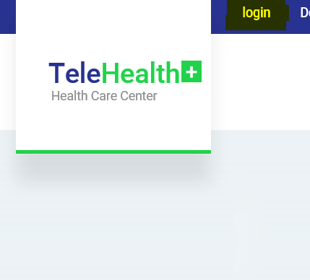
Logging in after Registration
Login button on home page
On Login page user has 2 choices
i) enter details and attempt Login
ii) “Forgot Password?” - retrieve details
Options to reset are only provided after registration from an existing account

Slide 27
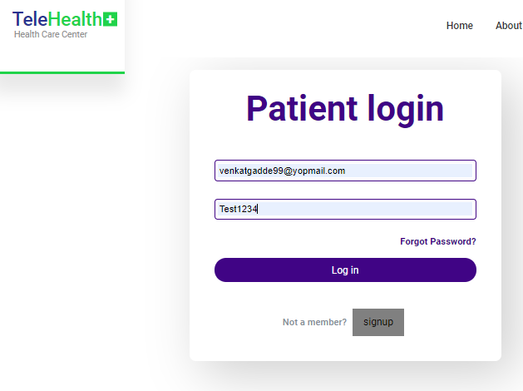
Patient Login

Slide 28
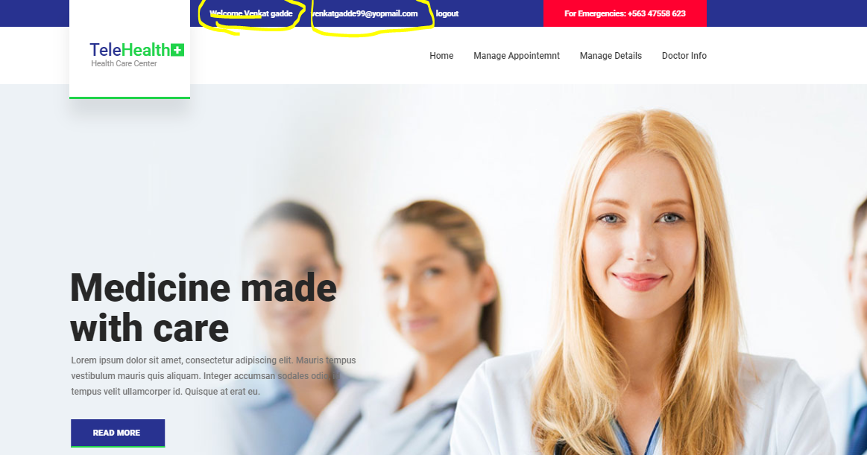

Slide 29
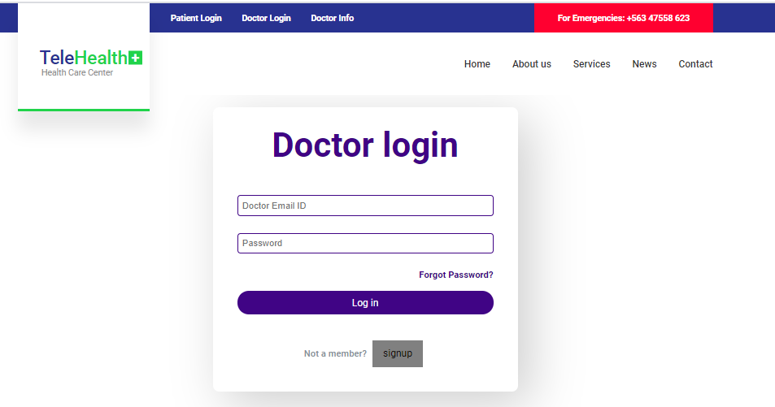
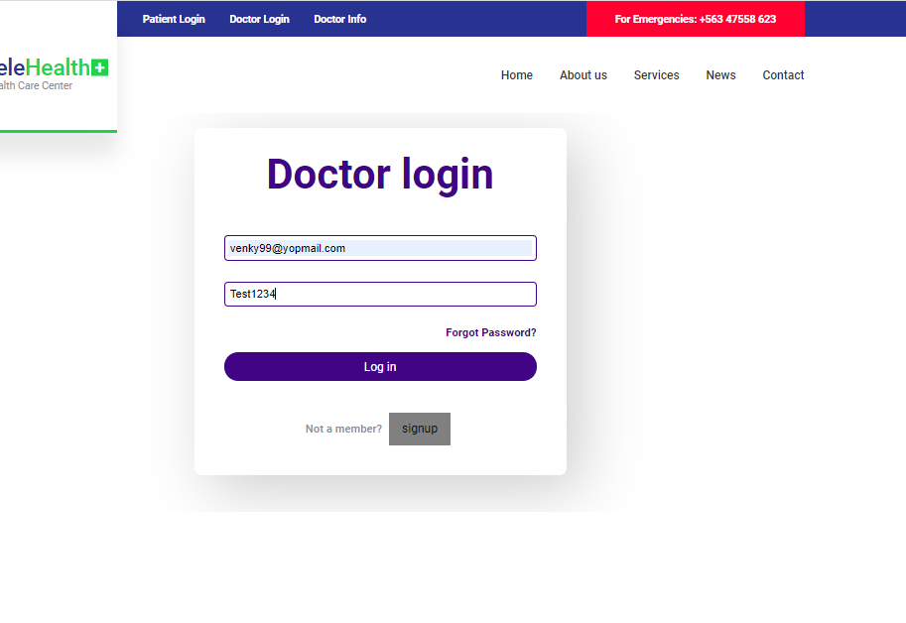
Doctor Login

Slide 30


Slide 31
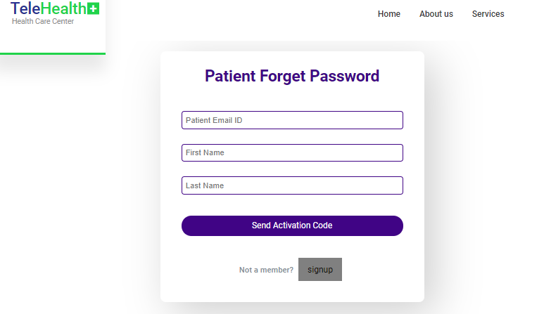
Patient Reset Password

Slide 32
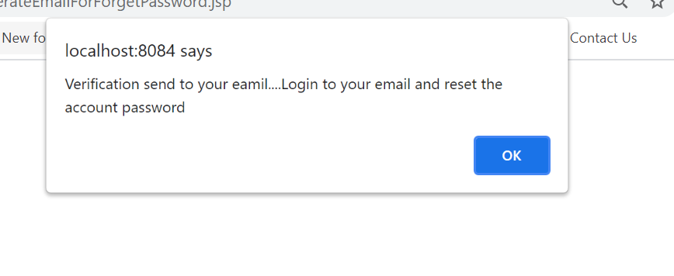
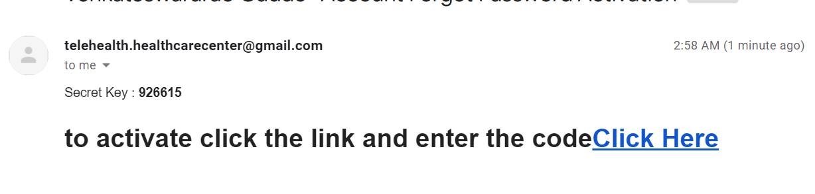

Slide 33
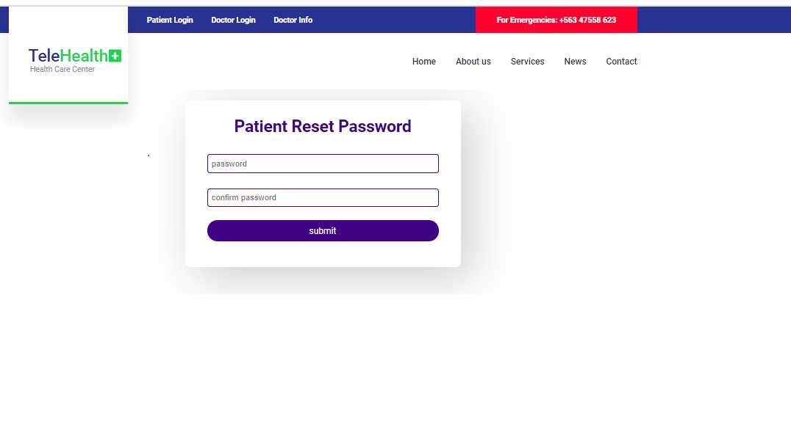

Slide 34
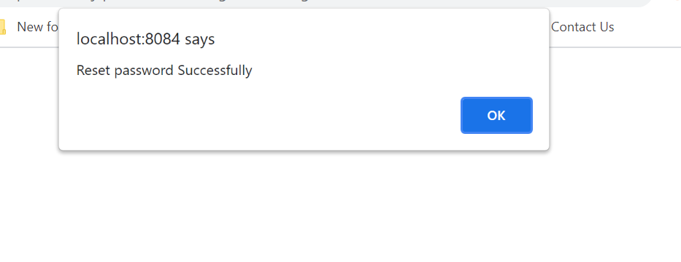

Slide 35
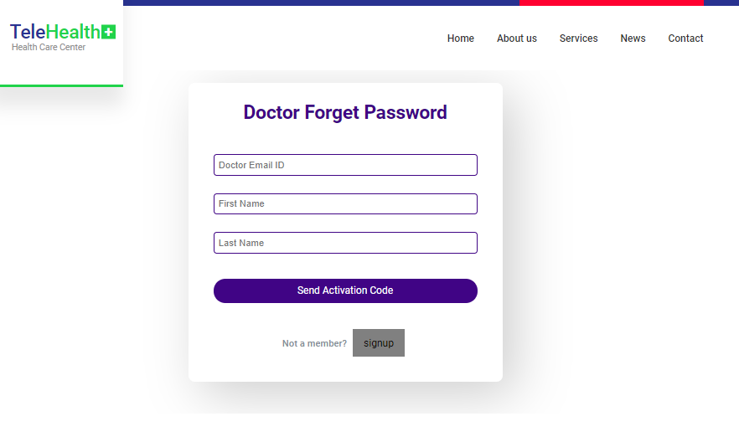
Doctor Reset Password
Doctor is asked for Email Id and Name to send activation code

Slide 37
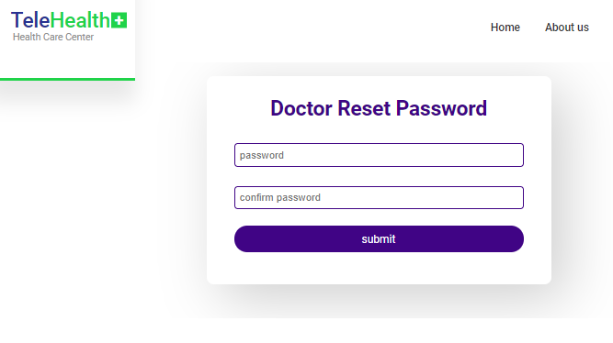

Slide 39
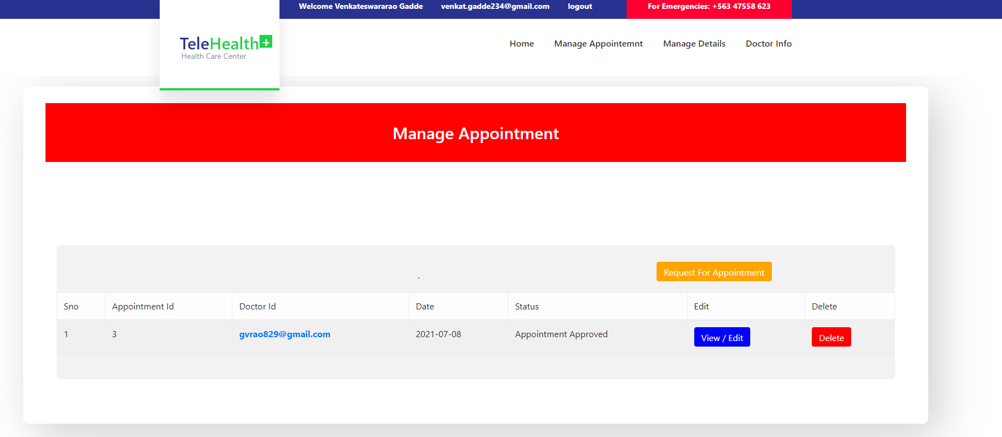
Manage Appointments (Patient)

Slide 40
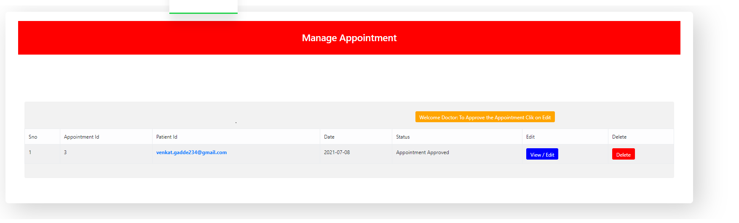
Manage Appointment (Doctor)

Slide 41
Patient/ Doctor Profile
In this page Patient can edit his/ her password, firstname, lastname

Slide 42
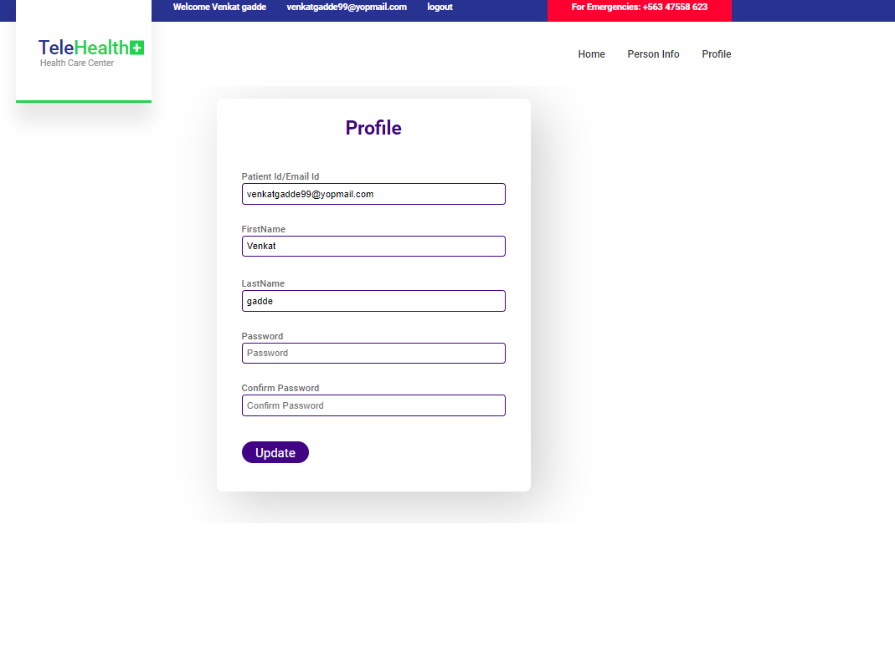

Slide 43
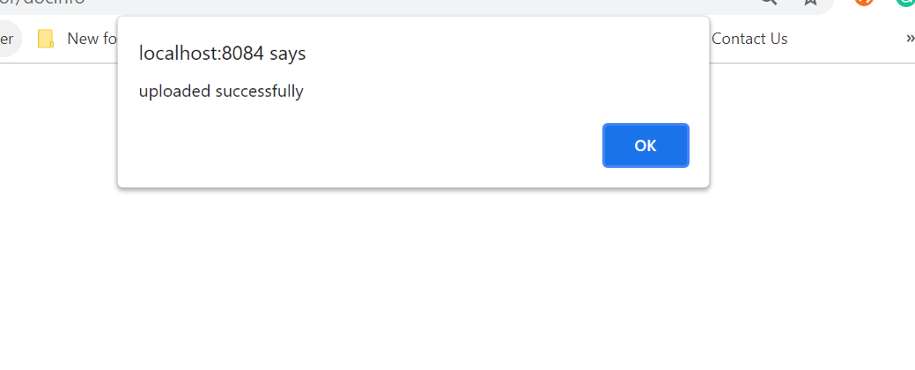

Slide 44

Requesting an Appointment

Slide 46
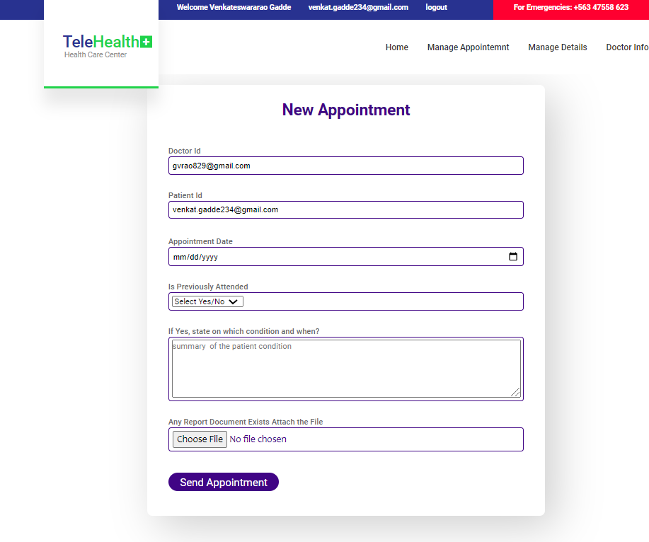

Slide 47
Patient Personal Info
The patient needs to fill in the following fields like username, gender, address etc.

Slide 48
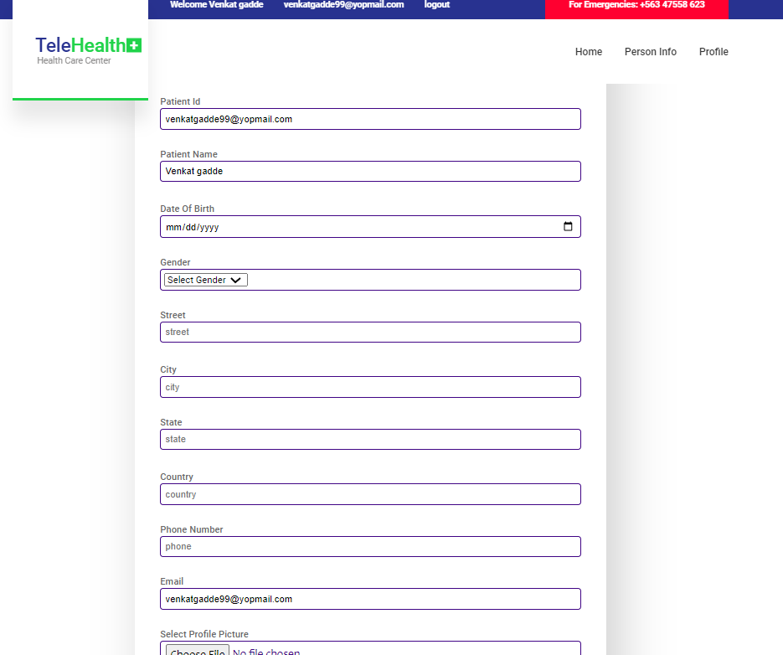

Slide 49
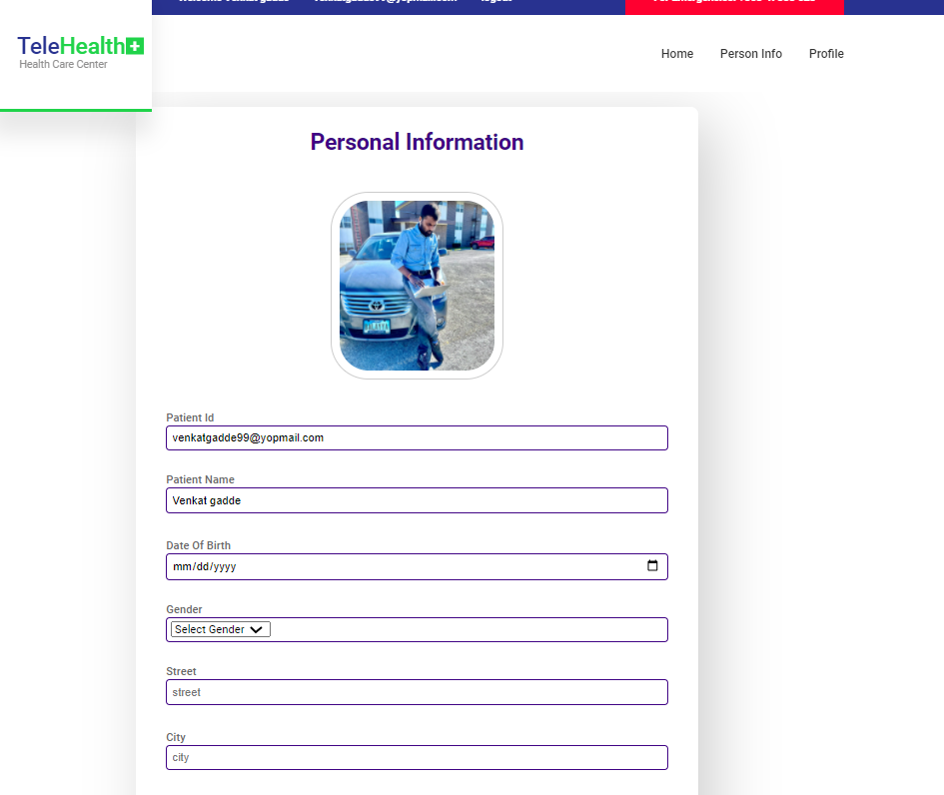

Slide 50
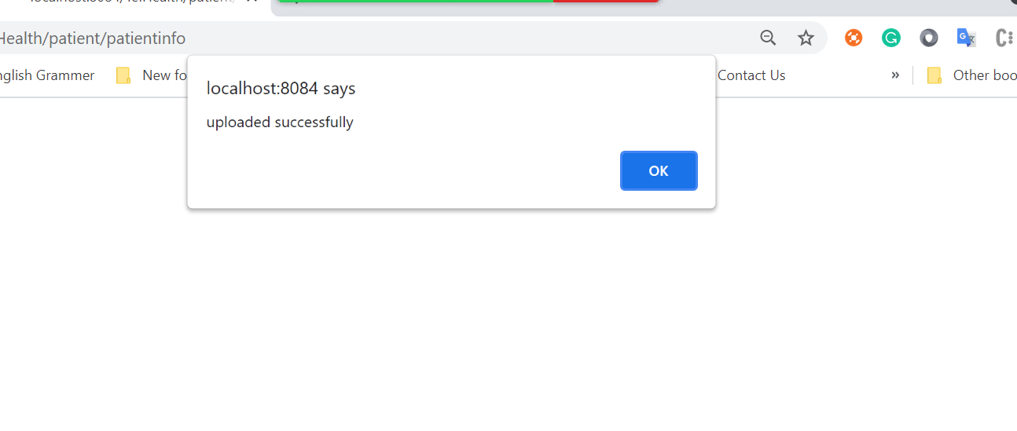

Slide 51
Doctor Personal Info
The doctor needs to fill in the following fields like username, gender, address etc.

Slide 52
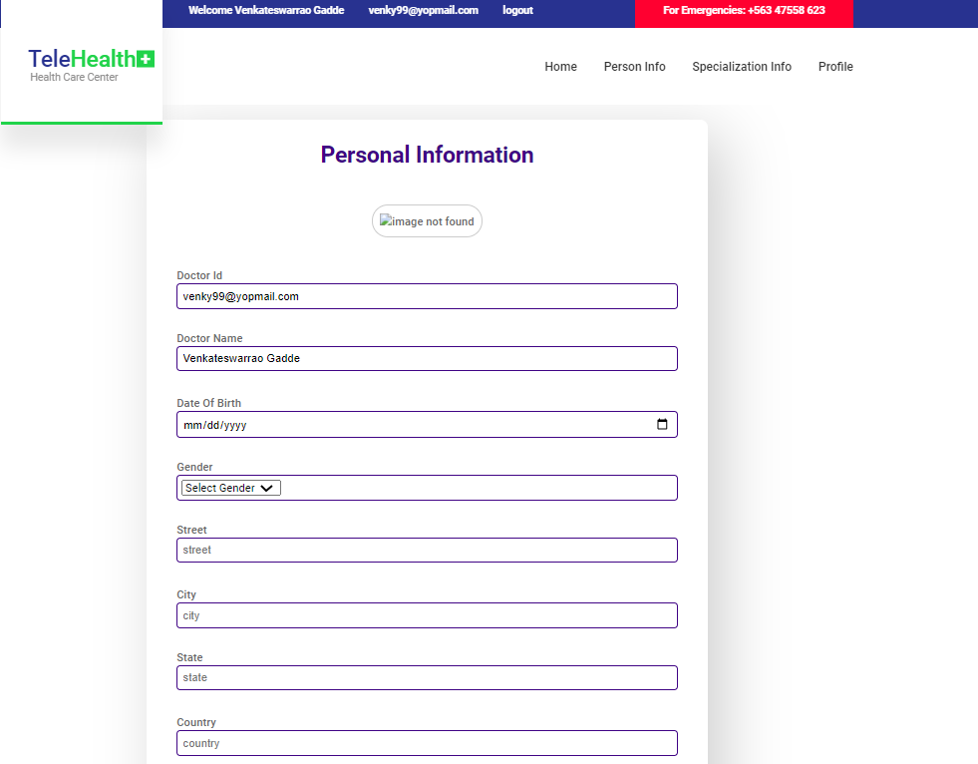

Slide 53
Doctor Specialisation
The doctor should update the fields with this professional qualifications, experience etc.

Slide 54
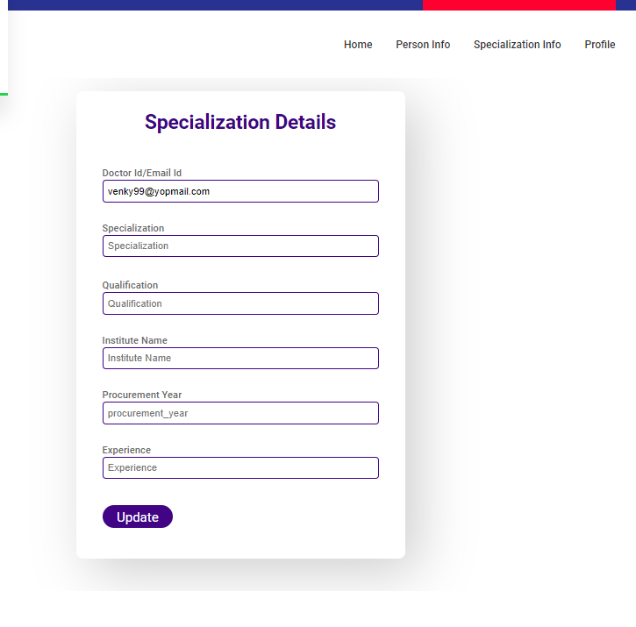

Slide 55
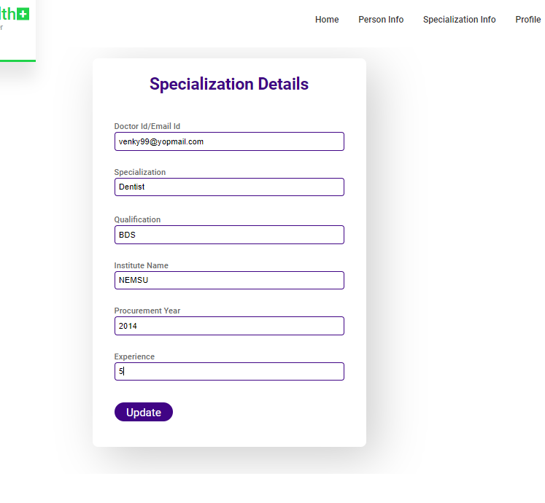

Slide 56
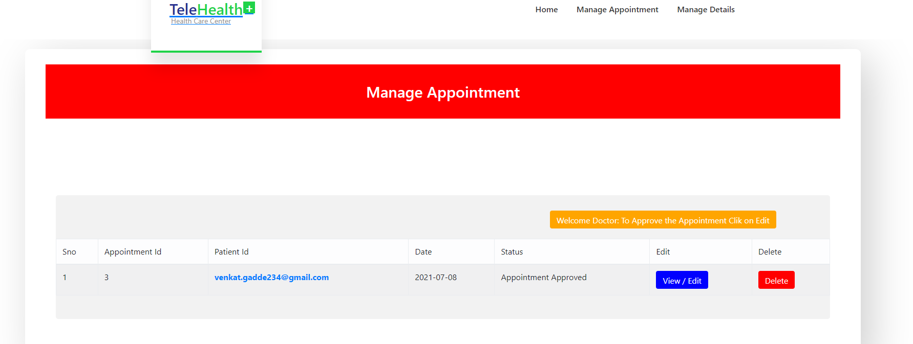
Request For Appointment

Slide 57
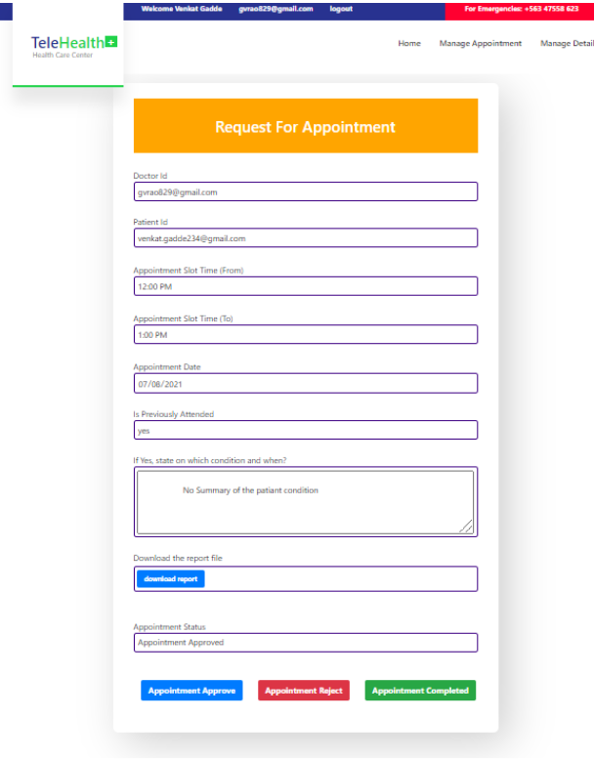

Slide 58
References
https://code.daypilot.org/44666/html5-doctor-appointment-scheduling-javascript-php
https://www.w3schools.com/bootstrap/
https://hibernate.org/
https://getbootstrap.com/docs/4.0/components/dropdowns/
https://www.authsmtp.com/gmail/
https://docs.user.com/imap-for-account-with-2-step-verification/

Slide 59
Thank you

